Slide 1
Mesh & Mesh-Free Numeric Methods
Megan Ewing & Noah Calhoun

Slide 2
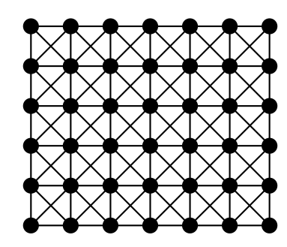
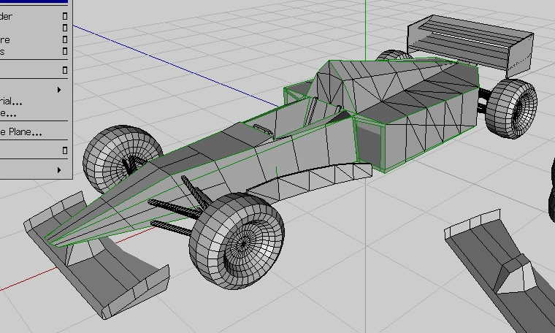
What is a mesh?
A mesh is a way to represent a structure using discrete units
It allows us to break a complicated 3d shape into simpler components for analysis and calculation
Partitions a space into portions which can be solved over individually
https://commons.wikimedia.org/wiki/File:Properties_of_a_polygon_mesh.svg

Slide 3
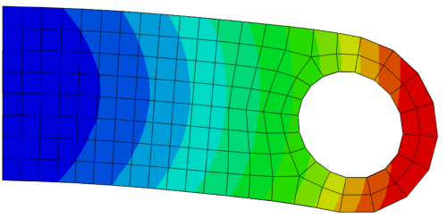
Mesh Method: Finite Element Method
Engineering problems like structural analysis, heat transfer, and fluid flow
Solving partial differential equations of 2 or more variables
Breaks the system in to smaller, simpler parts called finite elements
  This is a mesh of the object!!
Each element has an equation
Recombine all the element equations into a global system for the solution
https://learnfea.com/the_finite_element_method_for_linear_structural_analysis/

Slide 4
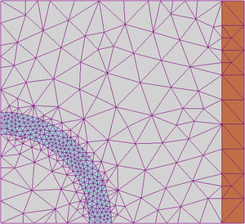
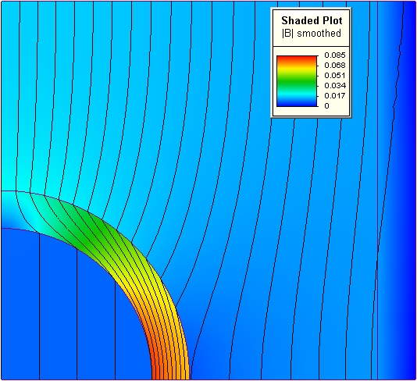
Finite Element Method Example
FEM mesh of magnetism problem: Color represents material,
Shapes are elements
FEM solution to magnetism problem:
Color represents magnetism,
Lines are magnetic flux
Notes:
Here is an example of the finite element method used to solve a magnetism problem. On the left, we have a mesh to represent the problem. Each color represents a different physical element of the problem; the red is a conducting wire coil, the blue is a magnetic iron cylinder, and the gray is air. Each triangle is a different element of the discrete domain. The elements are more concentrated in and around the area representing the iron. This allows for a more accurate solution in that area, while not wasting resources on less important areas.
On the right, we see the solution to this problem. The colors here the colors represent the strength of the applied magnetism, where red is the strongest. The lines, rather than representing the mesh, represent the magnetic flux. By using the finite element method, researchers were able to solve the partial differential equations to find that the iron cylinder is absorbing the magnetic flux, leaving the space behind the iron unmagnetized.

Slide 5
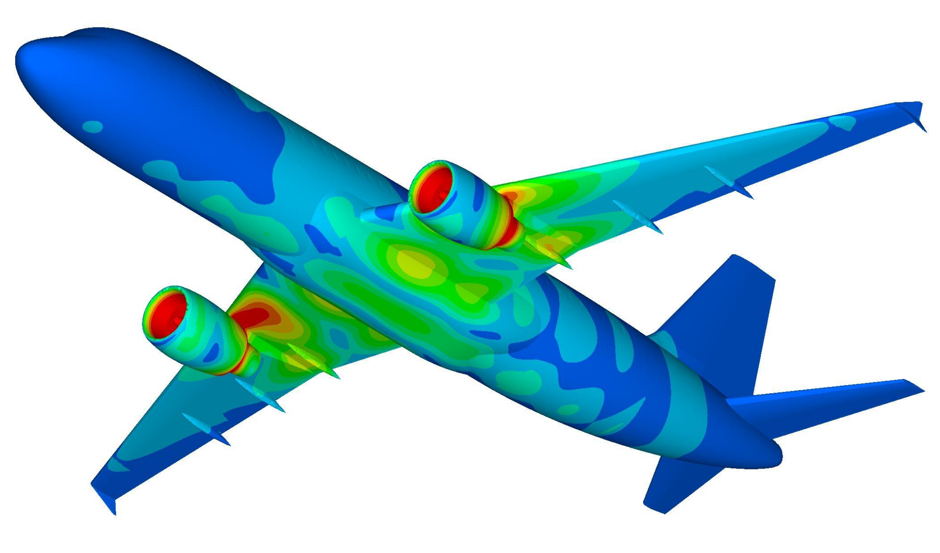
Finite Element Method Advantages
Accurately represents complex geometry
Includes properties of different materials
Easily represents the whole solution
Allows capture of most important effects
https://www.stressebook.com/wp-content/uploads/2014/08/Airbus_A320_k.jpg
Notes:
Here is an example of the finite element method used to solve a magnetism problem. On the left, we have a mesh to represent the problem. Each color represents a different physical element of the problem; the red is a conducting wire coil, the blue is a magnetic iron cylinder, and the gray is air. Each triangle is a different element of the discrete domain. The elements are more concentrated in and around the area representing the iron. This allows for a more accurate solution in that area, while not wasting resources with an accurate solution in the areas found to be less important.
On the right, we see the solution to this problem. The colors here the colors represent the strength of the applied magnetism, where red is the strongest. The lines, rather than representing the mesh, represent the magnetic flux. By using the finite element method, researchers were able to solve the partial differential equations to find that the iron cylinder is absorbing the magnetic flux, leaving the space behind the iron unmagnetized.

Slide 6
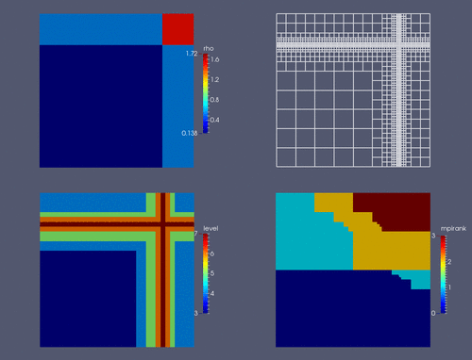
Mesh Methods Weaknesses
Making a mesh from a given shape is not trivial
  There are multiple algorithms for mesh generation
    Delauney Triangulation
  Not always ideal for FEM analysis especially in the three dimensional case
    Adaptive refinement
Mesh based methods also cannot do perfect material simulations
  Crack growth
  Bending
  Nonlinear behaviour outside of element boundaries
Adaptive mesh refinement
https://commons.wikimedia.org/wiki/File:Adaptive_mesh_refinement_illustration.gif

Slide 7
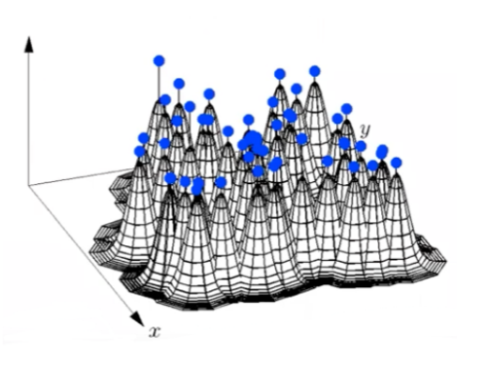
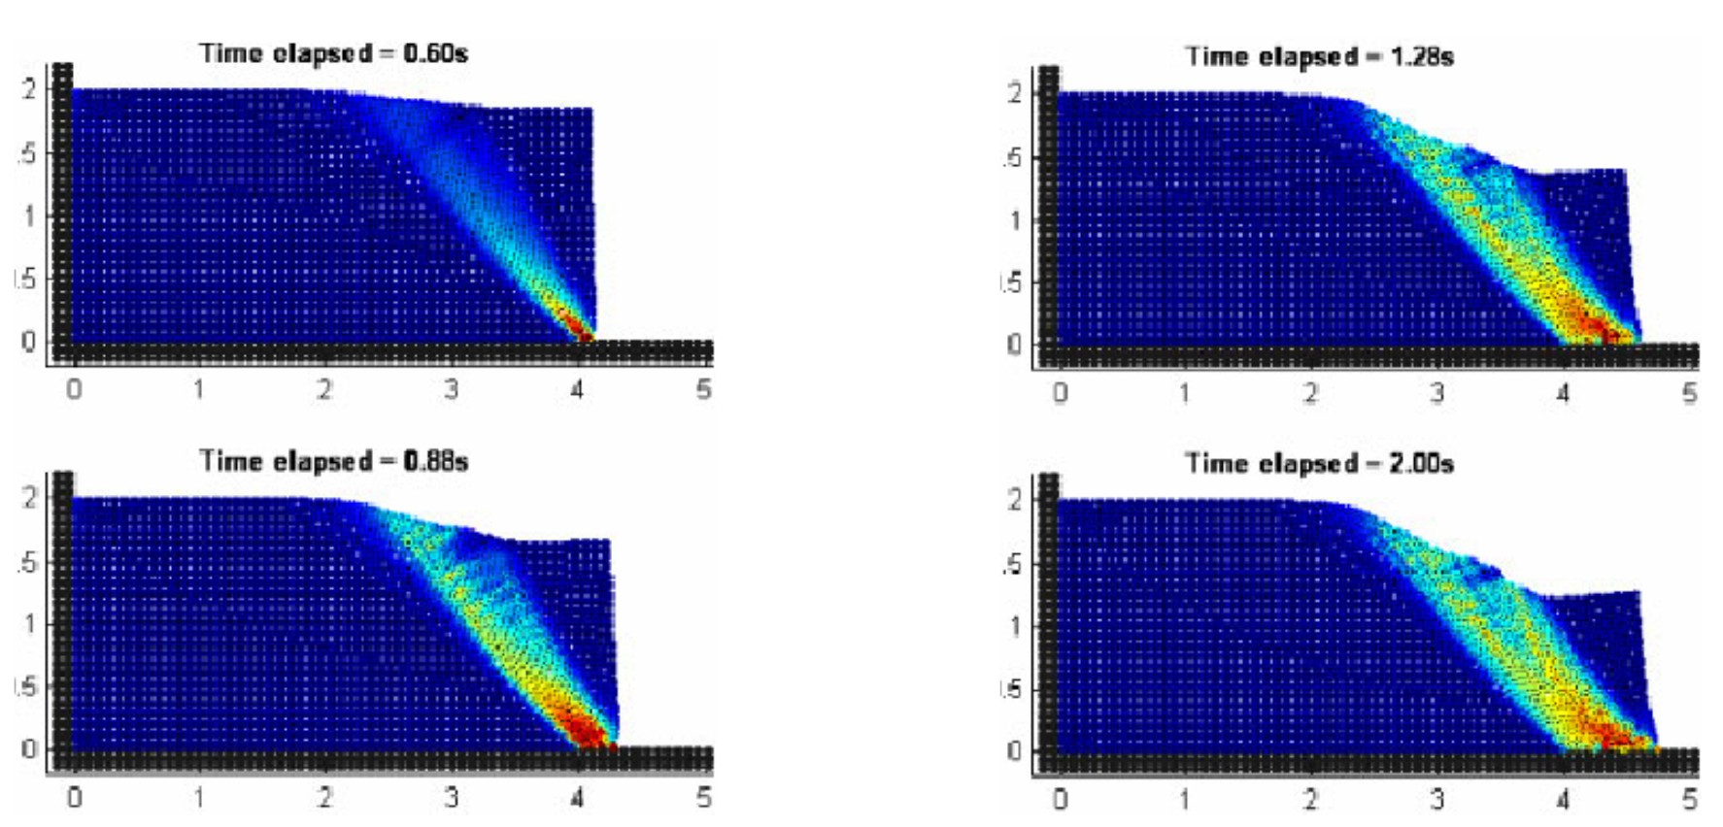
Meshfree Methods
Methods which do not create a mesh for use in calculation
Instead analyse the whole set of points
Examples include:
  Radial Basis Function Interpolation
    No underlying grid or adjacency structure
  Smoothed Particle Hydrodynamics
    Automatic conservation of mass

Slide 8
Mesh or Meshfree?
Meshed
  Fixed neighbors for every element
  Accurate for large shapes and deformations
  Cracks and discontinuities can only form around the boundaries between elements
  Can be computationally expensive to generate good meshes
  Boundary conditions easy to describe
  Doesn’t work well for high precision fluid simulation
Mesh-free
  Simulates un-connected yet interacting elements
  Accurate for smaller scale fluid simulation or crack formation
  Can be expensive for large and detailed objects
  Boundaries are harder to set
  Doesn’t work for some types of simulation i.e. magnetic fields

Slide 9
Questions?

Slide 10
Sources
Mesh Generation Algorithms
Finite Element Method
Mesh-free Methods
Smoothed Particle Hydrodynamics
Information on Mesh-Free Methods

